Slide 1

Slide 1 of 39
Predicting pneumonia disease using CNN
Supervised By
Dr. Sabah Sayed
TA. Menna Youssef

Slide 2


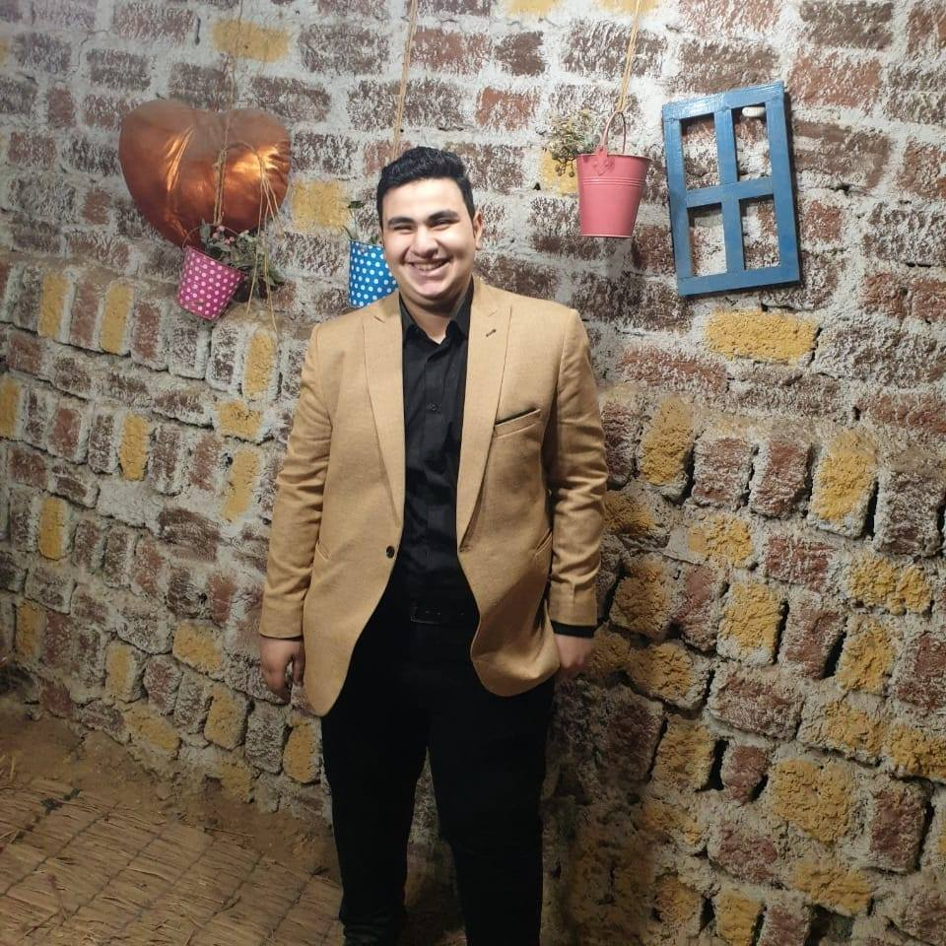
Slide 2 of 39
Team members
01
02
03
Diaa Ahmed Refat
Mostafa Mohamed
Abdelrahman Mohsen

Slide 3
Slide 3 of 39
Domain of interest
Computer vision
Project idea
In our project we predicting
pneumonia disease using CNN

Slide 4

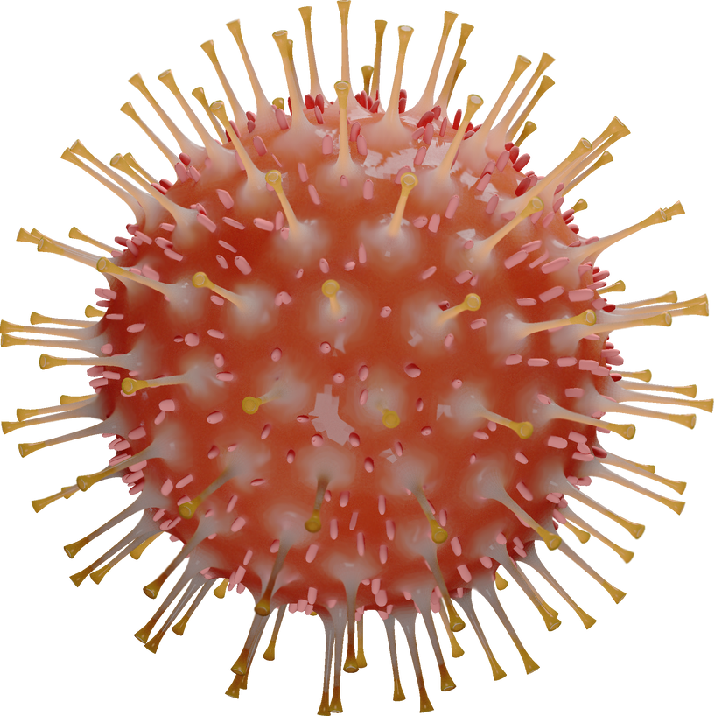
Agenda
Slide 4 of 39
01
Introduction
02
Introduction on what is our project
03
Problem definition
What is our problem
04
Related work
Talk about related work of our problem
Related work problems
Problems in related work
05
06
Solution
How we solved this problems
07
Results
Show results
System specification
08
Talk about diagrams
Demo for website
Show test cases of the website

Slide 5
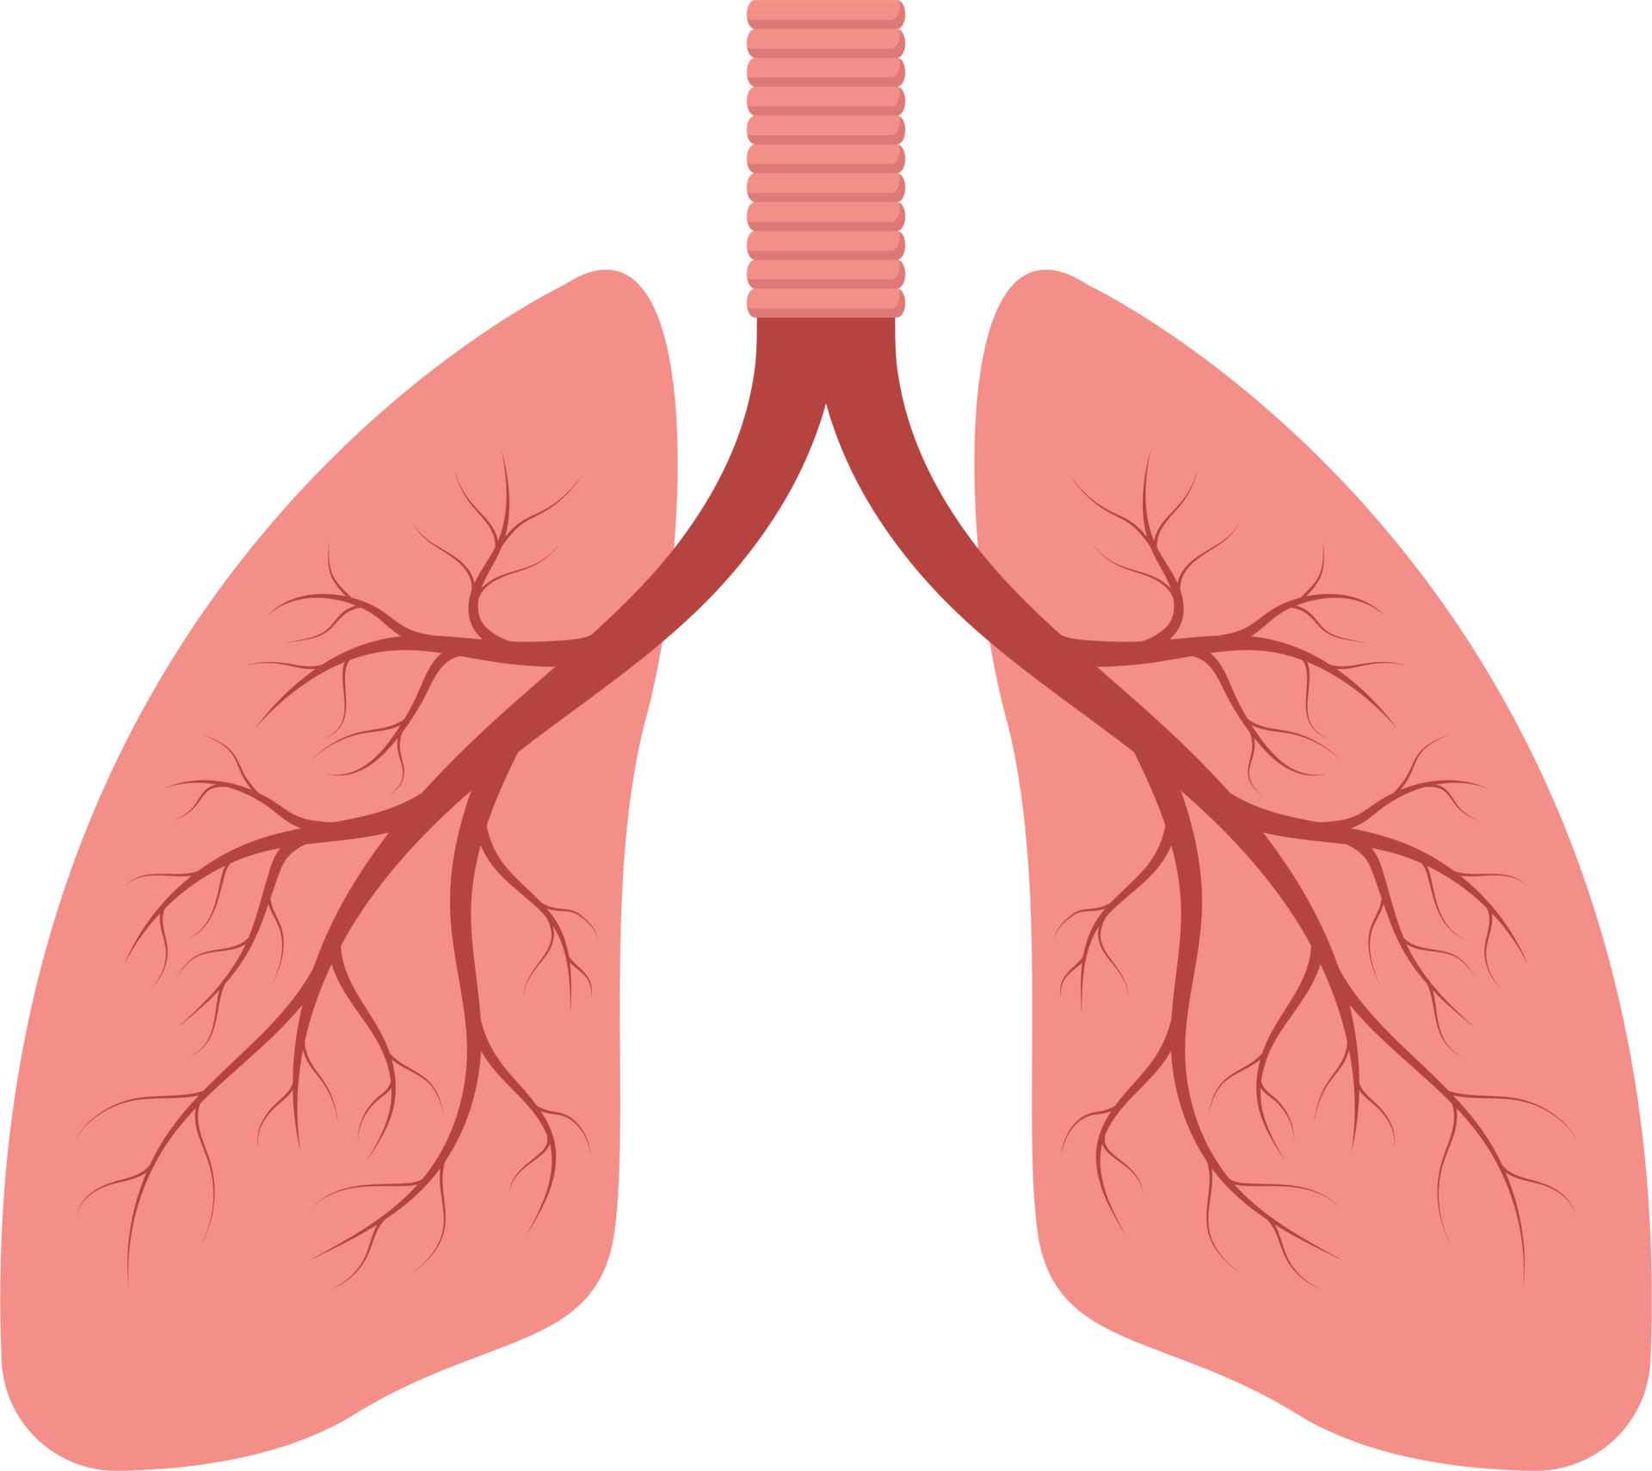
Introduction
Slide 5 of 39
What is pneumonia?
A severe respiratory infection that damages the lungs is known as pneumonia.
Why pneumonia get increasing?
In the last years covid-19 appears with a lot of symptoms one of them is pneumonia

Slide 6

Introduction
Slide 6 of 39
Why we choose pneumonia detection by CNN?
The goal of pneumonia detection using CNNs is to develop an efficient and accurate method for early detection and diagnosis of pneumonia, which can ultimately improve patient outcomes and reduce the burden of the disease on healthcare systems

Slide 7
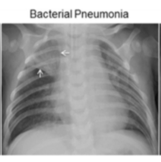
Introduction
Slide 7 of 39
How doctor detect Pneumonia using chest x ray

Slide 8
Problem Definition
Slide 8 of 39
We need to make a model to predict pneumonia using CNN by using Chest-x ray image from the user
For this problem our target is to find the best model and the best accuracy
The importance of this project :
We will have a tool to early detect of the pneumonia
Save a lot of human lives, because around 16% of all deaths of children under 5 years old dies because of pneumonia this mean killing approximately 2,400 children a day in 2015 in USA.
Have a high accuracy lead to have reliable model or tool to detect pneumonia also have a tool why this model
classify this.

Slide 9
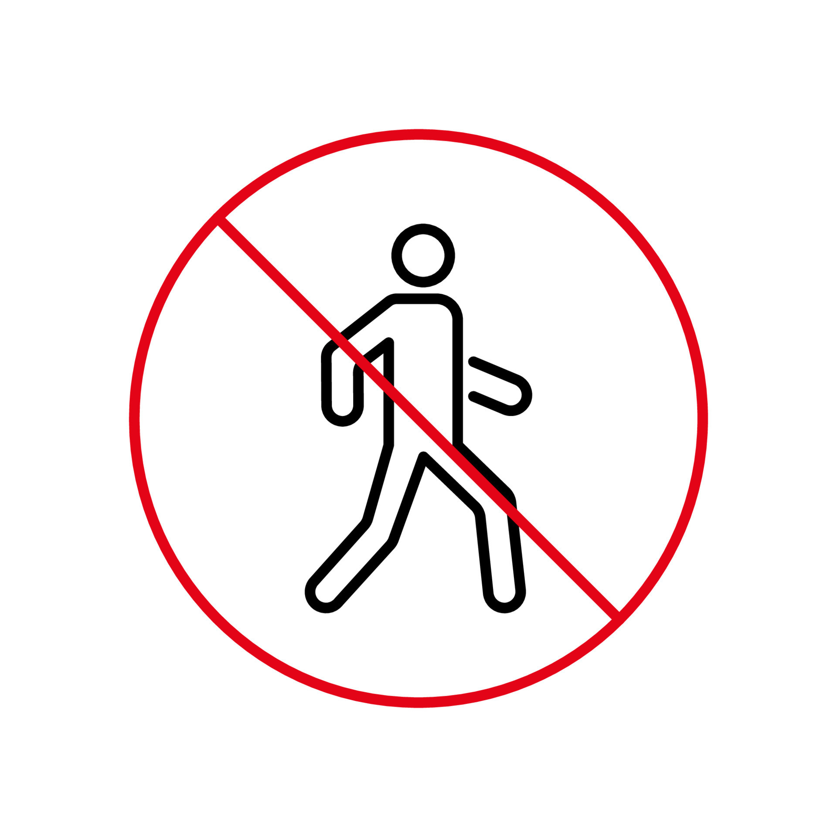


Problem Definition
Slide 9 of 39
So, we can ask question why we can use model to predict instead of traditional methods?
It could take time to get the result from your doctor to check
In covid-19 there was ban for walk in some country so you cannot go to the doctor
It costs money for the doctor or hospital

Slide 10
Problem definition
Slide 10 of 39
The solution by using computational method like our project
Build a good model with good accuracy this model takes a photo and classify pneumonia or normal this mean we have computer vision problem
This will save money and also time because our website will be free for everyone just user join and enter information and upload photo so he don’t need to go anywhere

Slide 11
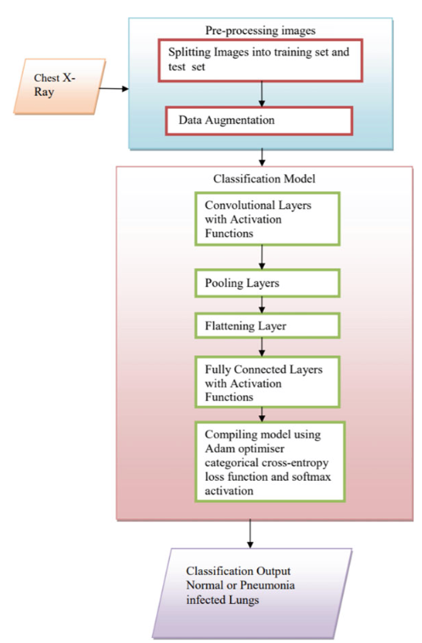
Related work
Slide 11 of 39
First paper authors V. Sirish Kaushik, Anand Nayyar, Gaurav Kataria and Rachna Jain
They used four models to compare and take the best of them and this is the structure of the process
Conclusion of the paper
The validation accuracy, recall and F1 score of CNN classifier model 3 with three convolutional layers are 92.31%, 98% and 94%, respectively, which are quite high compared to other models that were trained. CNN classifier model 4 with four convolutional layers also comes very close in performance with 91.67% validation accuracy, 98% recall and 94% F1 score. Both models have the same recall and F1 scores.

Slide 12
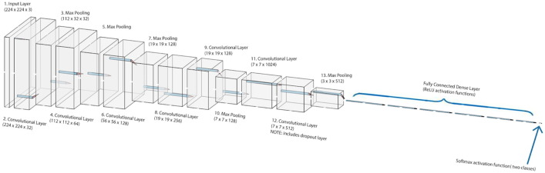
Related work
Slide 12 of 39
Second paper authors Patrik Szepesi, László Szilágyi (published on ScienceDirect)
They used architecture like VGG-16 architecture in that some of its early layers follow a similar structure of convolutional layer, batch normalization layer, activation layer, which is finally followed by a pooling layer
They provide a GitHub repo for their source code this make us understand the process in a good way
They used other papers to compare the results of them and their results

Slide 13
Related work problems
Slide 13 of 39
Problems in paper one
First, they didn’t use transfer models, but they used a model that they built in their task, but we used transfer learning because our target is to get the highest accuracy.
And they used all the data set on their task, but they didn’t take comments that say that the data on the test file have a lot of wrong labels and it makes the training have low accuracy.
Also, they seem used the data with the problem of imbalance and this is big problem they will get high recall but low precision and that what happened on their models what makes f1 score is lower than ours

Slide 14
Related work problems
Slide 14 of 39
Problems in paper two and comparison
they used all the data from three files in their process
they also used the data without balance the data
They also used 50 epochs for this task, and this is making the computational cost very high which it takes like 2 hours to train it on Kaggle GPU
Efficient net is recent CNN architecture and show state of art in the computer vision field and they didn’t include this architecture in their comparison

Slide 15
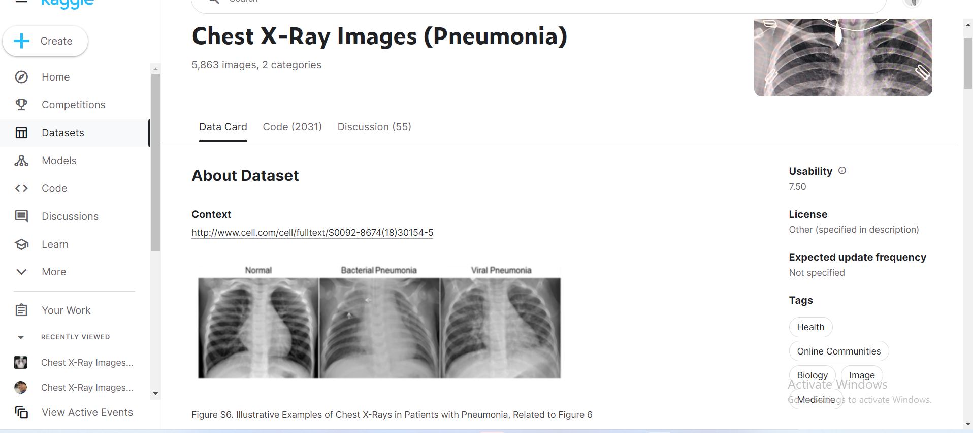
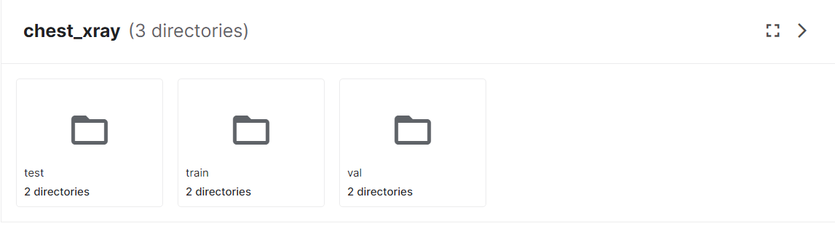
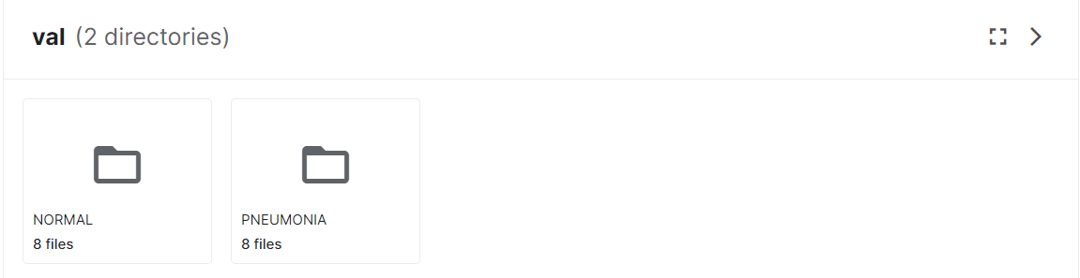
Solution
Slide 15 of 39
Data we used in this problem
We get the data from Kaggle
Data was split into three folders Test and Train and validation
Data splitting was not good for Test and validation there were only 16 image for validation then we will ignore it and we used it to test model on the website and re splitting it
For the analysis of chest x-ray images, all chest radiographs were initially screened for quality control by removing all low quality or unreadable scans

Slide 16
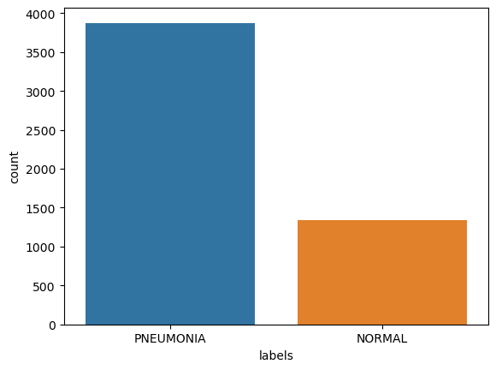
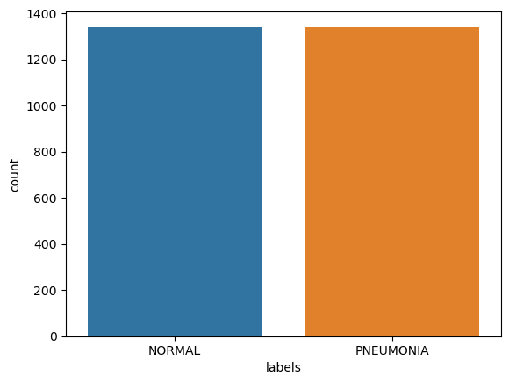
Solution
Slide 16 of 39
Get the data and preprocessing
The data we are using 5,863 X-Ray images (JPEG)and 2 categories (Pneumonia/Normal) in three folders test and Val and train
The data is imbalanced as shown in figure 1
We will be resampling it to be balance as shown in figure 2
We will split data into 80% train and 12% validation and 8% test
Figure 1
Figure 2

Slide 17
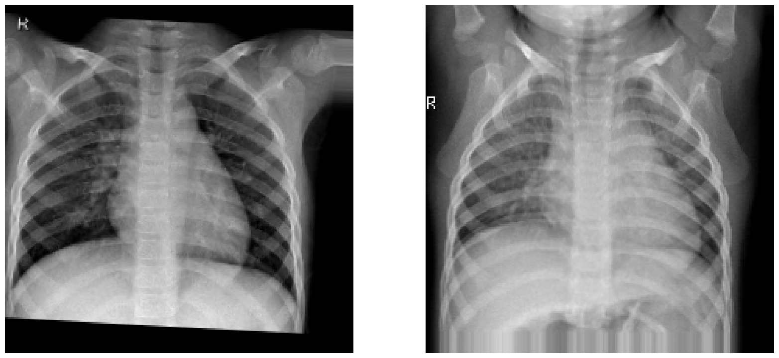
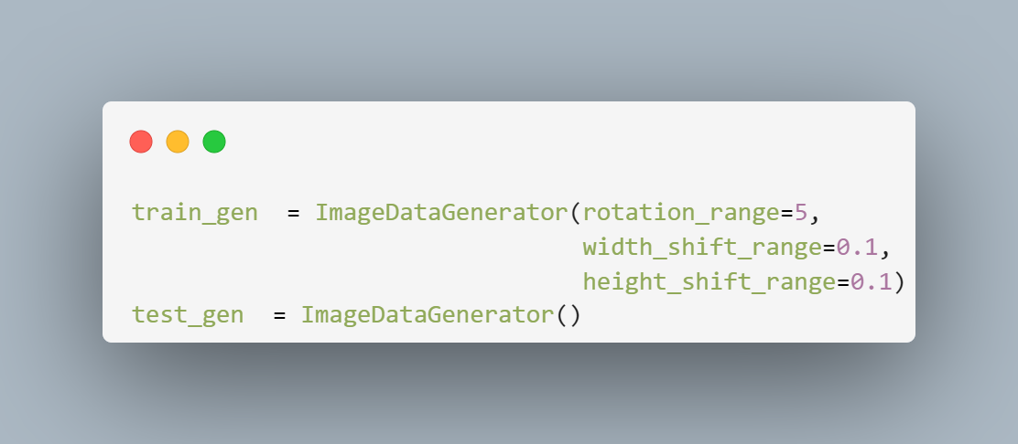
Solution
Slide 17 of 39
Data Augmentation
Data augmentation is a technique used in machine learning to increase the size and diversity of the training dataset by creating new samples from the original dataset
We found the best augmentation to do in this problem as the field of study is to make some basics things on the images like rotation and width shift and height shift

Slide 18
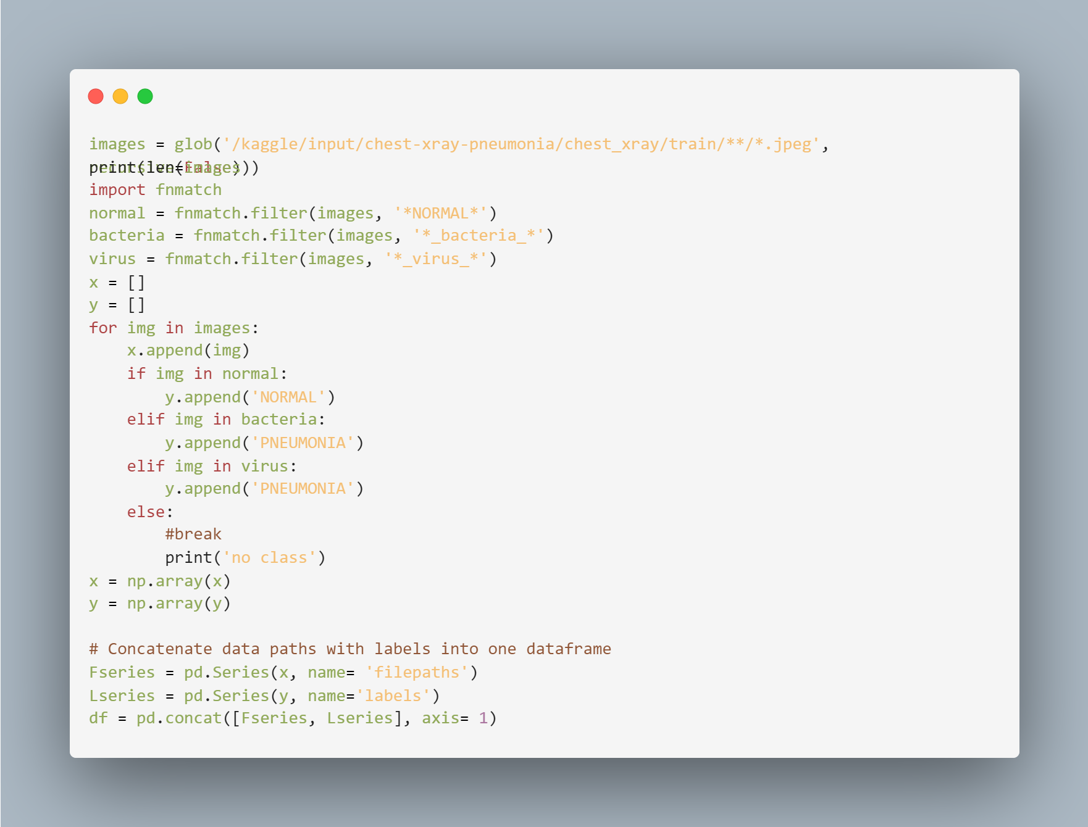

Solution
Slide 18 of 39
Problems on Data and preprocessing
As we discussed data split into three files train and test and validation
After reading some comments on Kaggle we found that like 80% of users talks about test folder of the data,
That there is about 50 % of Normal labels seems to be wrong
We solved this problem by ignoring test folder from our training process
The code below show how we get data from folders

Slide 19
Solution
Slide 19 of 39
Methods and call backs for models
Checkpoint
Adamax
Early stop
Reduce learning rate on plateau
Drop out
AdaMax is an optimization algorithm, which is a variant of the Adam optimization algorithm that is designed to converge faster than the classical stochastic gradient descent (SGD) method.
Used to save weights of the lowest model validation lost
Used with patience =5 to stop model if the val loss didn’t increased after 5 epochs
Reducing learning rate if the model didn’t improved for 5 epochs it will reduce by factor 0.8
Used to avoid over fitting by making neurons off and we used 0.5 for the dropout

Slide 20

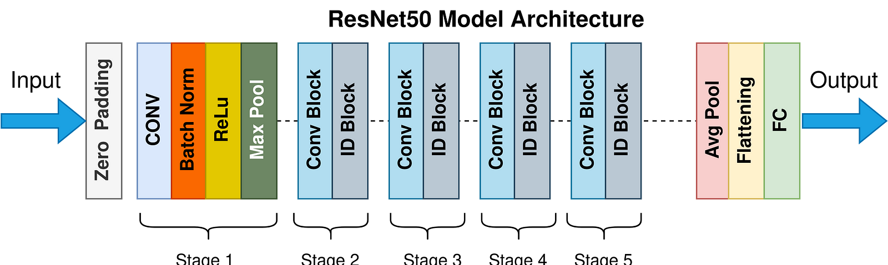
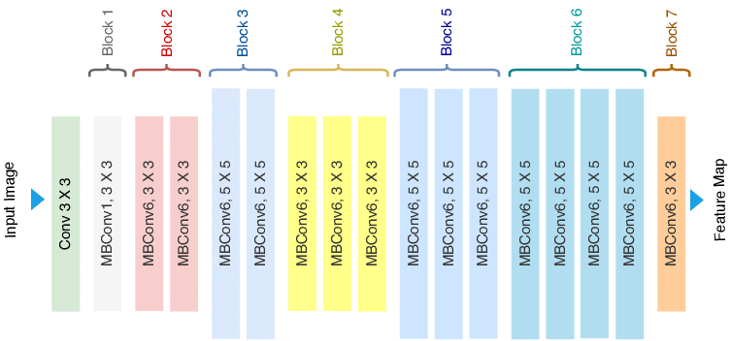
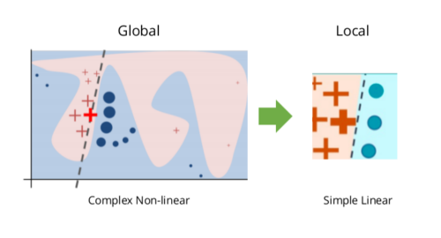
Solution
Slide 20 of 39
Models' architecture and technique used for this problem
VGG16
Resnet50
E net (proposed model)
Lime
The model consists of 13 convolutional layers and three fully connected layers, and it has a large number of weight parameters, close to 550MB in size, leading to the model being relatively large
Efficient Net uses a novel compound scaling method that uniformly scales the depth, width, and resolution of the network. This allows it to achieve state-of-the-art accuracy with significantly fewer parameters and computations than other popular models
a technique for explaining the predictions of black box machine learning models in a way that is easy to understand and interpret.
The model has 48 convolutional layers, one max pool layer, and oneaverage pool layer.

Slide 21
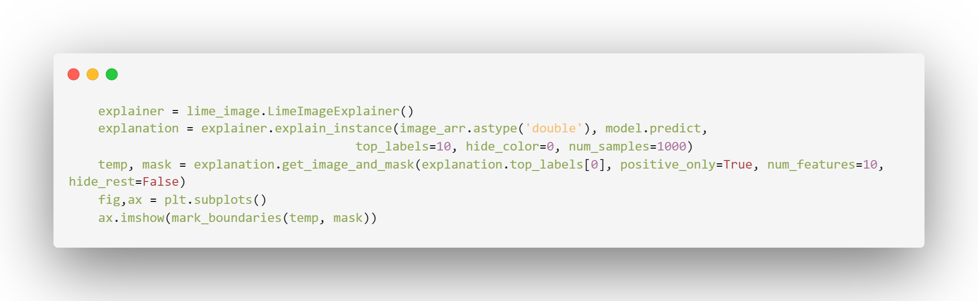
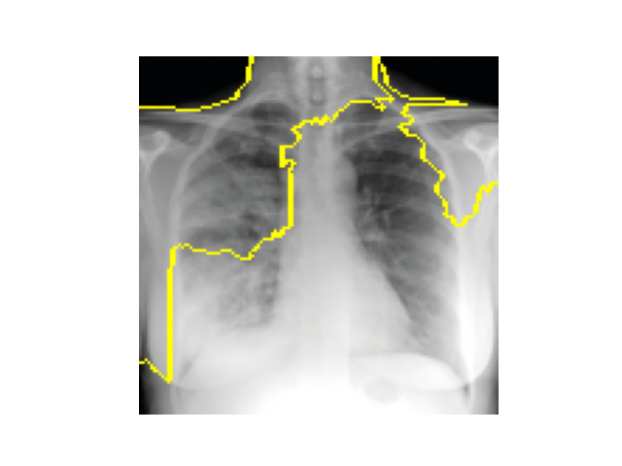
Solution
Slide 21 of 39
Lime Explanation
When we think about how we can make this tool helpful for the doctors we think about lime
We used this explanation and other method to mark boundaries on the position that’s why our model classify the patient in this way in the pneumonia case
In this figure below show pneumonia case photo with boundaries drawn around features that makes our model to classify this photo as pneumonia patient

Slide 22
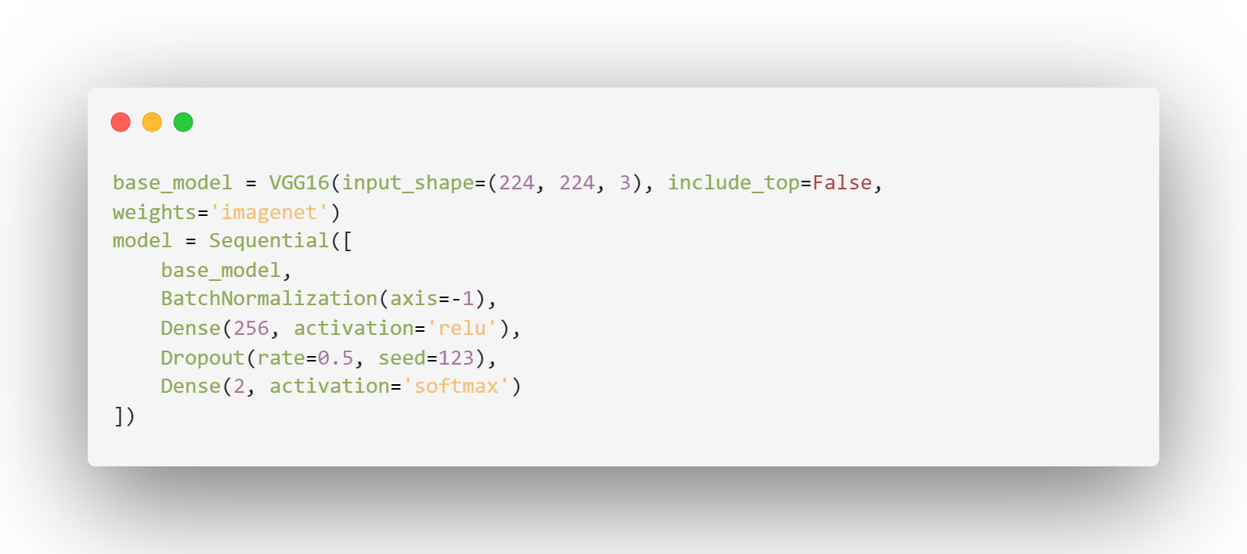
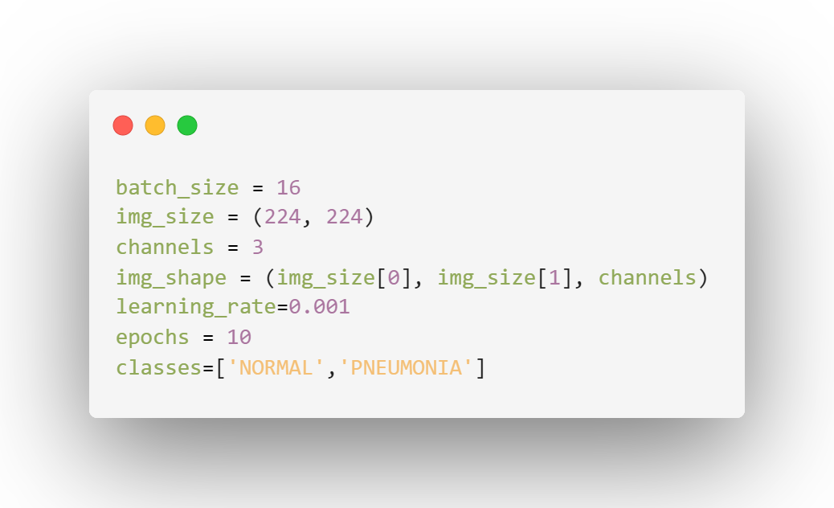
Solution
Slide 22 of 39
Implementation and training models
We make all hyperparameters on cell to edit it with appropriate way
We used keras.application to load architecture we want use and we used image net weights as initialization
We created the model with some additional layers like batch normalization and drop out and dense and we also used SoftMax with 2 neurons as it is binary classification problem

Slide 23
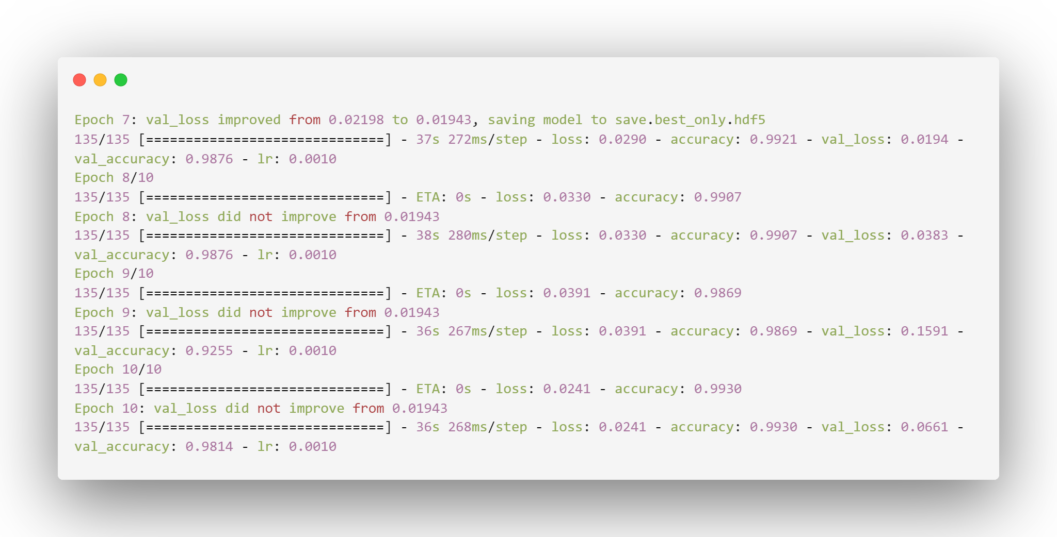
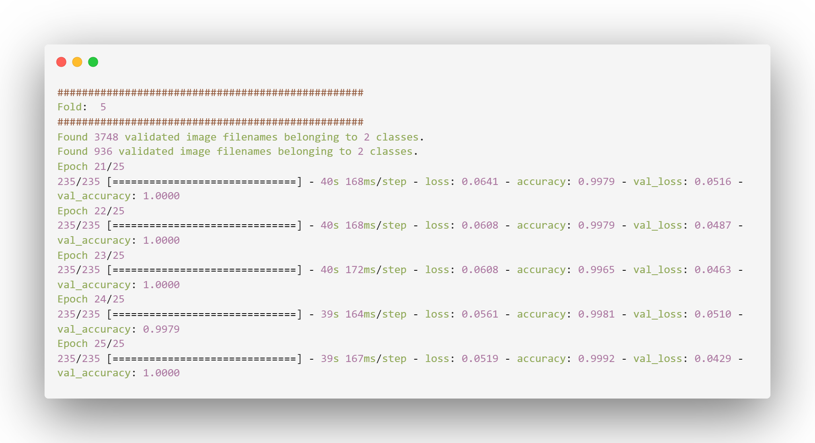
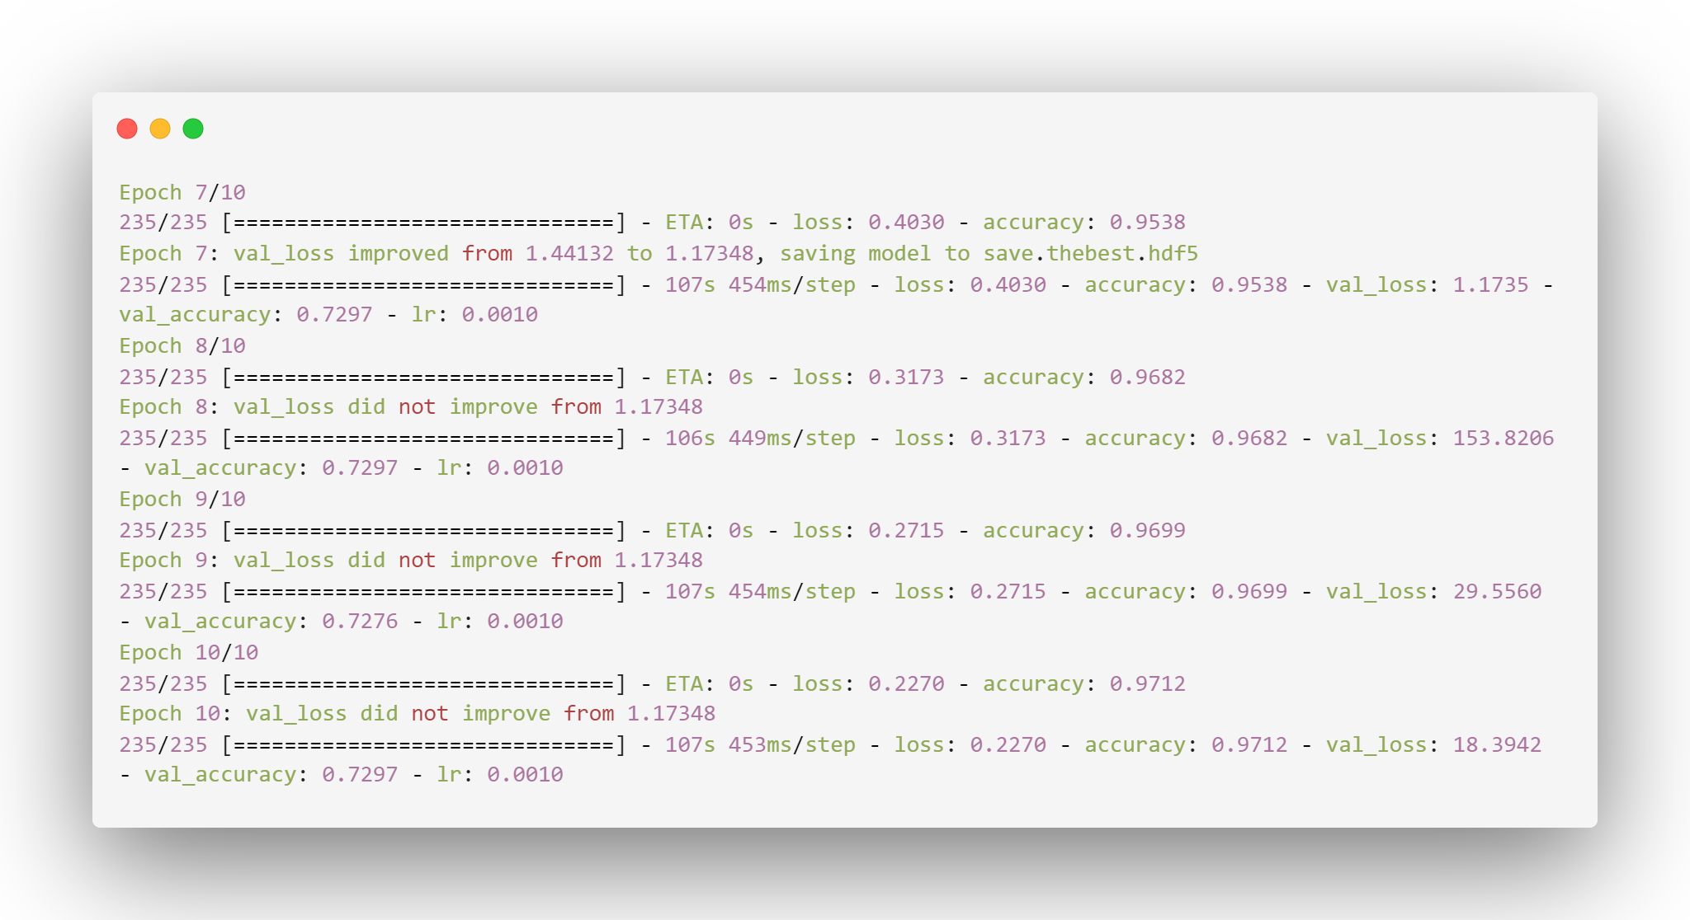
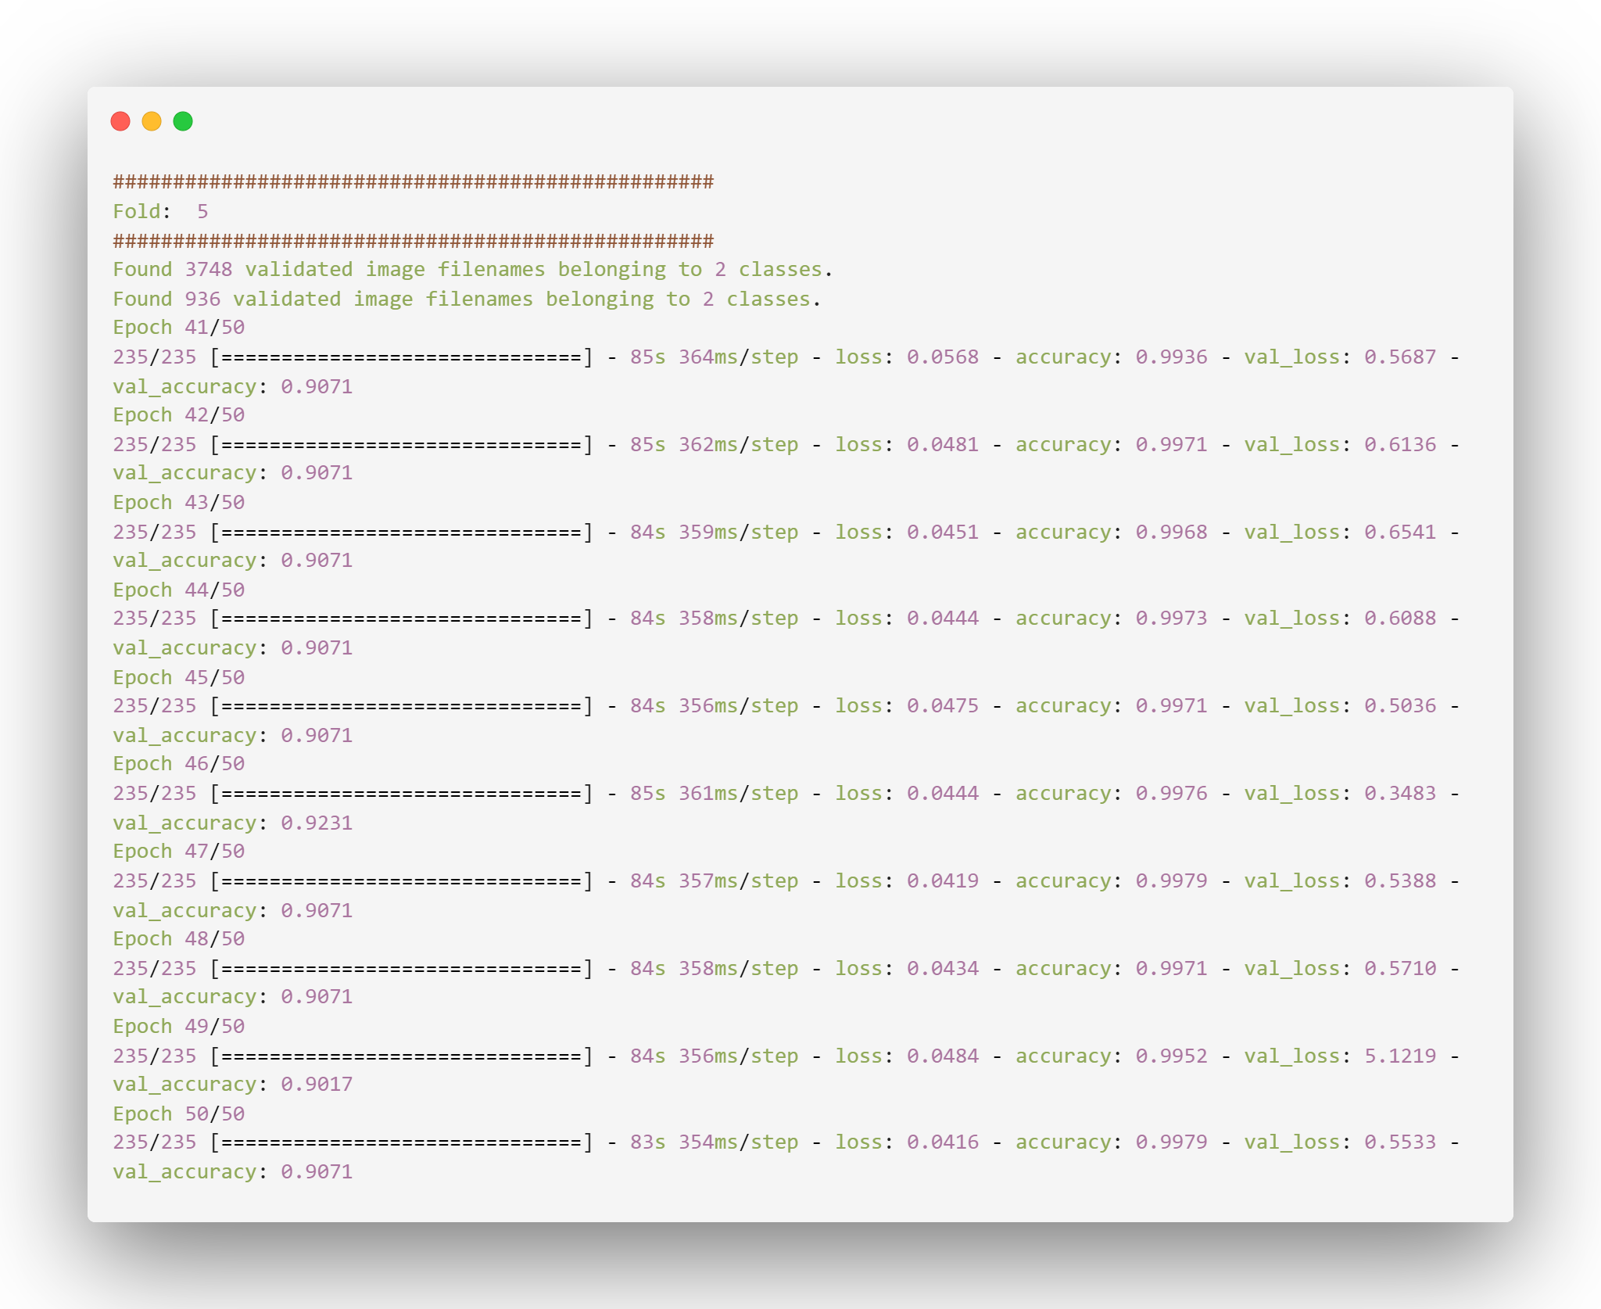
Solution
Slide 23 of 39
Final training phase model
Problems in the training phase we solve it
First we had a problem when we use rescaling method on the augmentation we have problems
Second when we try to solve it by using k folds cross validation method
When we removed rescaling method and use k folds cross validation

Slide 24

Efficient net Model V.B4 Vs other version
Slide 24 of 39
Good classifier with high accuracy
Overfitting problem
It gives us about 98% on the test data.
It gives us about 99% on the test data and around 100% on the train data .
What’s app trick !!
Fast on training to get best result
Fast on training to get best result
We just used 10 epochs to get this result of the model we don’t need more
We just used 10 epochs to get this result of the model we don’t need more
Generalized to predict new data
Not Generalized to predict new data
When we tried deferent photos we found that this version is generalized
When we tried the same photo but with less quality we found that the model gives us bad results
Note: results in the two version was likely to be the same but when we tried version less than b4 we found that it gives us wrong predictions

Slide 25
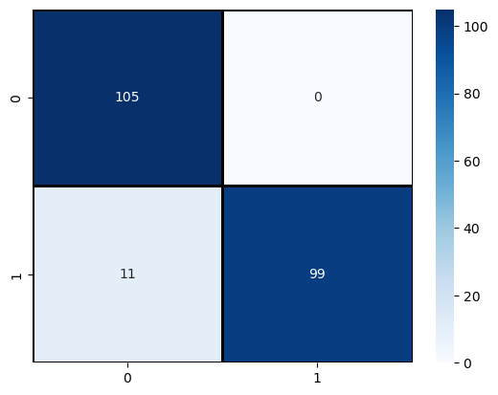
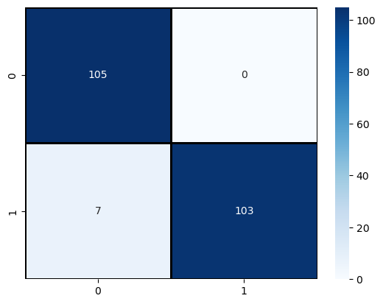
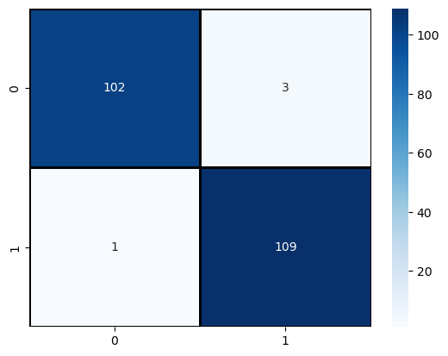
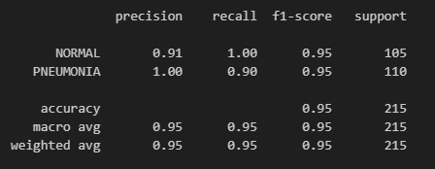
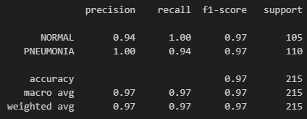
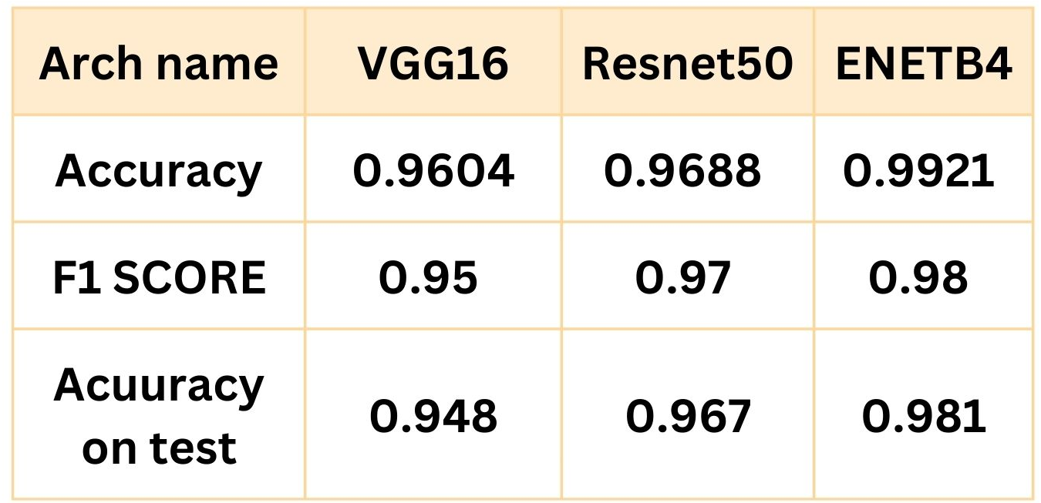
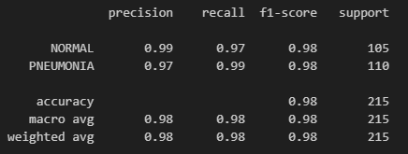
Results
Slide 25 of 39
VGG16
Results of the models
resnet50
Enet b4
VGG16
After we trained the three models, we found out that the best model is efficient net version B4 this gives us around 98.1 accuracy
resnet50
Enet b4

Slide 26
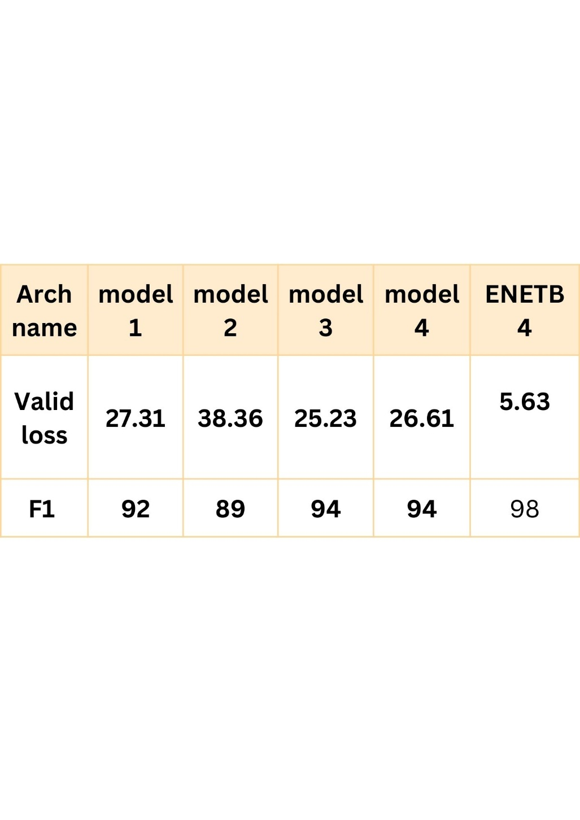
Results
Slide 26 of 39
Comparison of paper one and our model

Slide 27
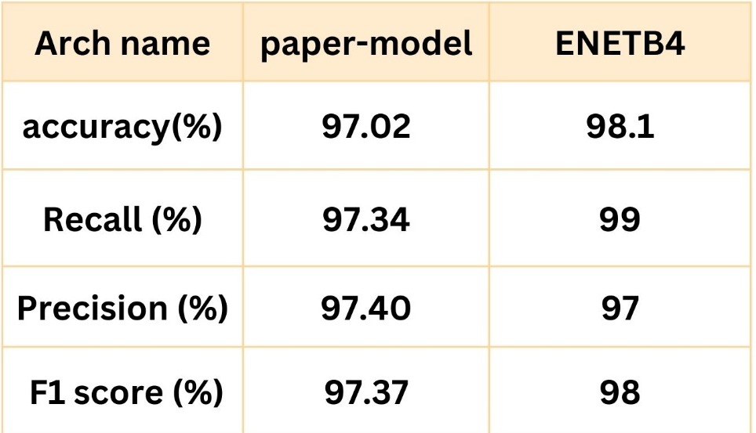
Results
Slide 27 of 39
Comparison of paper two and our model

Slide 28
Project specification
Slide 28 of 39
Functional requirement:
1. Image Classification: The system should be able to classify chest X-ray images as either infected (pneumonia) or normal using a CNN model, specifically an efficient net.
2. User information: The web application should allow users to enter their personal information, including name, phone number, email address, age, gender, and marital status.
3. Symptom Selection: Users should be able to select the presence and severity of various symptoms associated with pneumonia, such as cough, fever, shortness of breath, chest pain, chills, headache, muscle aches, nausea or vomiting, and confusion.
4. Medical History and Comments: The system should provide an input field for users to enter their medical history and any additional comments.
5. Data Storage: The system should store user information, symptom details, and uploaded chest X-ray images in a database.
6. Image Upload: Users should be able to upload a chest X-ray image for examination.
7. Examination Result: After image analysis, the system should provide the user with the examination result, indicating whether the X-ray suggests an infection or is normal.
Functional requirement:

Slide 29
Project specification
Slide 29 of 39
Non-Functional requirement:
1. Accuracy: The CNN model should have a high accuracy rate, preferably around 99%, in classifying chest X-ray images.
2. Performance: The system should process user input and image classification quickly to provide a timely examination result.
3. User Interface: The web application's front-end should have an intuitive and user-friendly interface using HTML and CSS.
4. Security: User data, including personal information and medical history, should be securely stored and protected.
5. Scalability: The system should be able to handle an increasing number of user registrations, image uploads, and database entries without significant performance degradation.
6. Reliability: The system should be reliable, ensuring that user data is accurately stored and retrieved from the database.
7. Compatibility: The web application should be compatible with various web browsers and devices to ensure accessibility for users.

Slide 30
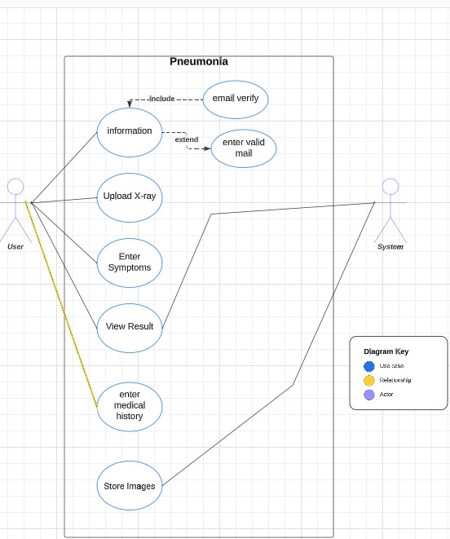
Project specification
Slide 30 of 37
Use case diagrams

Slide 31
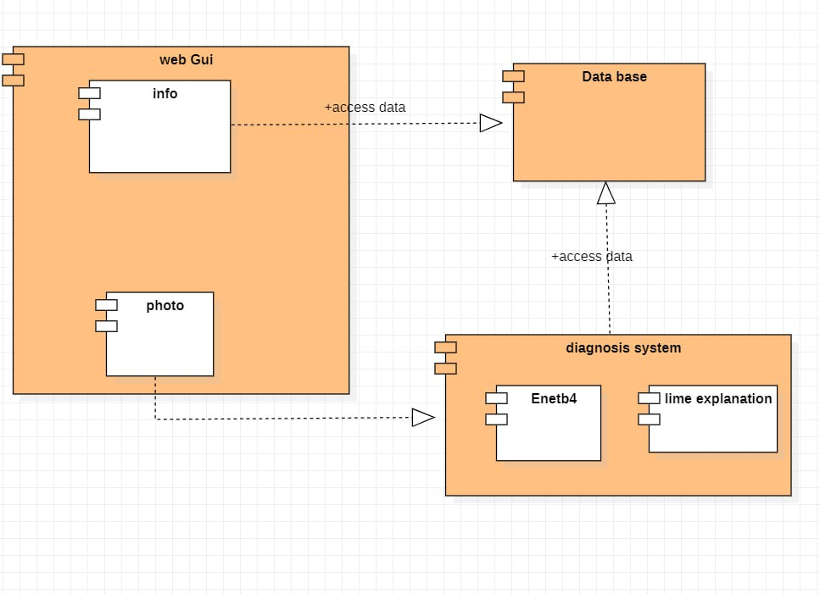
Project specification
Slide 31 of 39
System Component Diagram

Slide 32
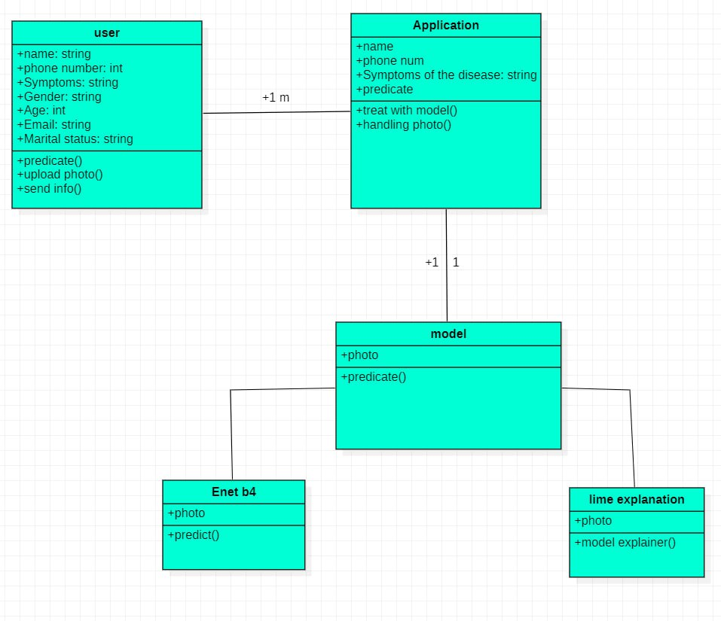
Project specification
Slide 32 of 39
System Class Diagrams

Slide 33
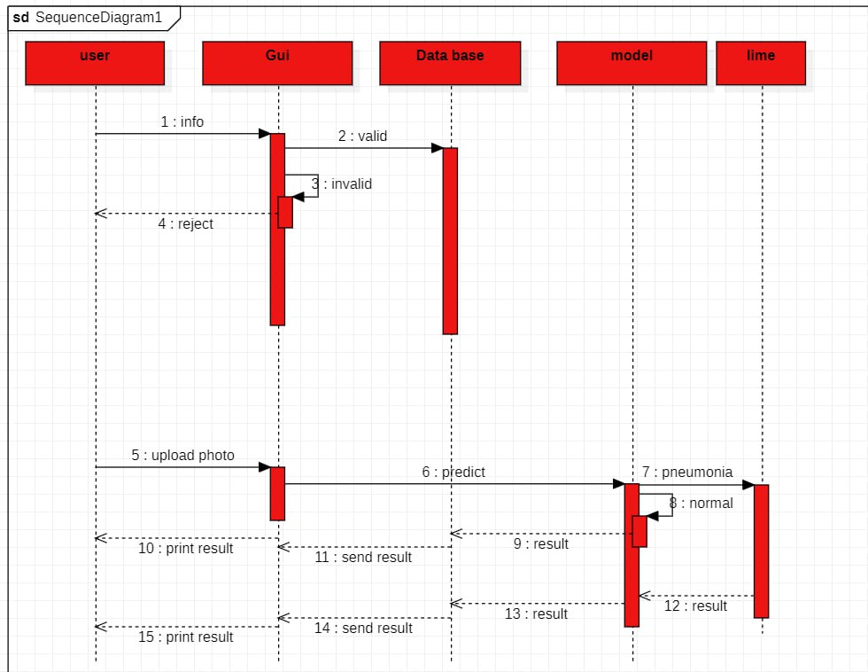
Project specification
Slide 33 of 39
Sequence Diagram

Slide 34
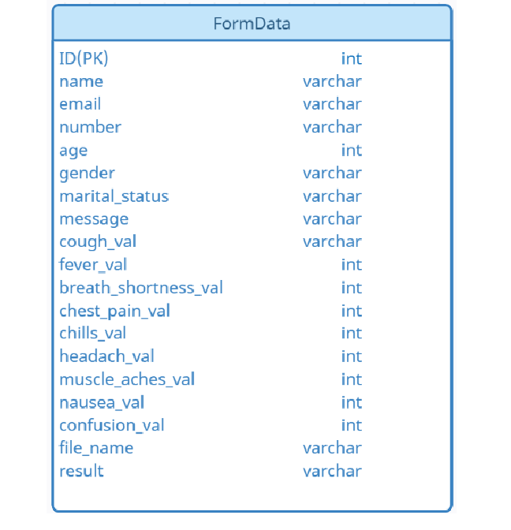
Project specification
Slide 34 of 39
ERD

Slide 35
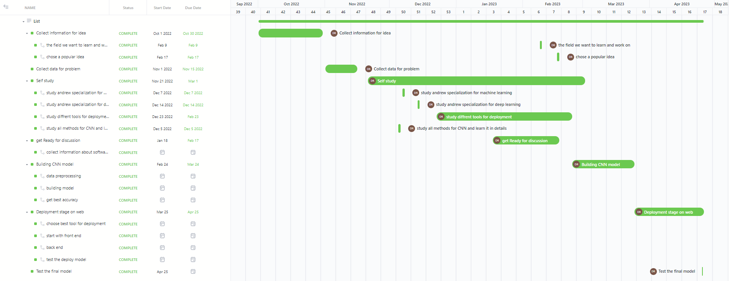
Time plan
Slide 35 of 39
Gantt chart

Slide 36



Future Work
Slide 36 of 39
We will add on our website access to user to retrieve all his predictions from his ID and we will retrieve all data from the table on the database.
And, we will add a button on the website for users to download our database as excel sheet
By add this features users and health organization will have a method to determine and train new models and make analysis
Functional requirement:

Slide 37
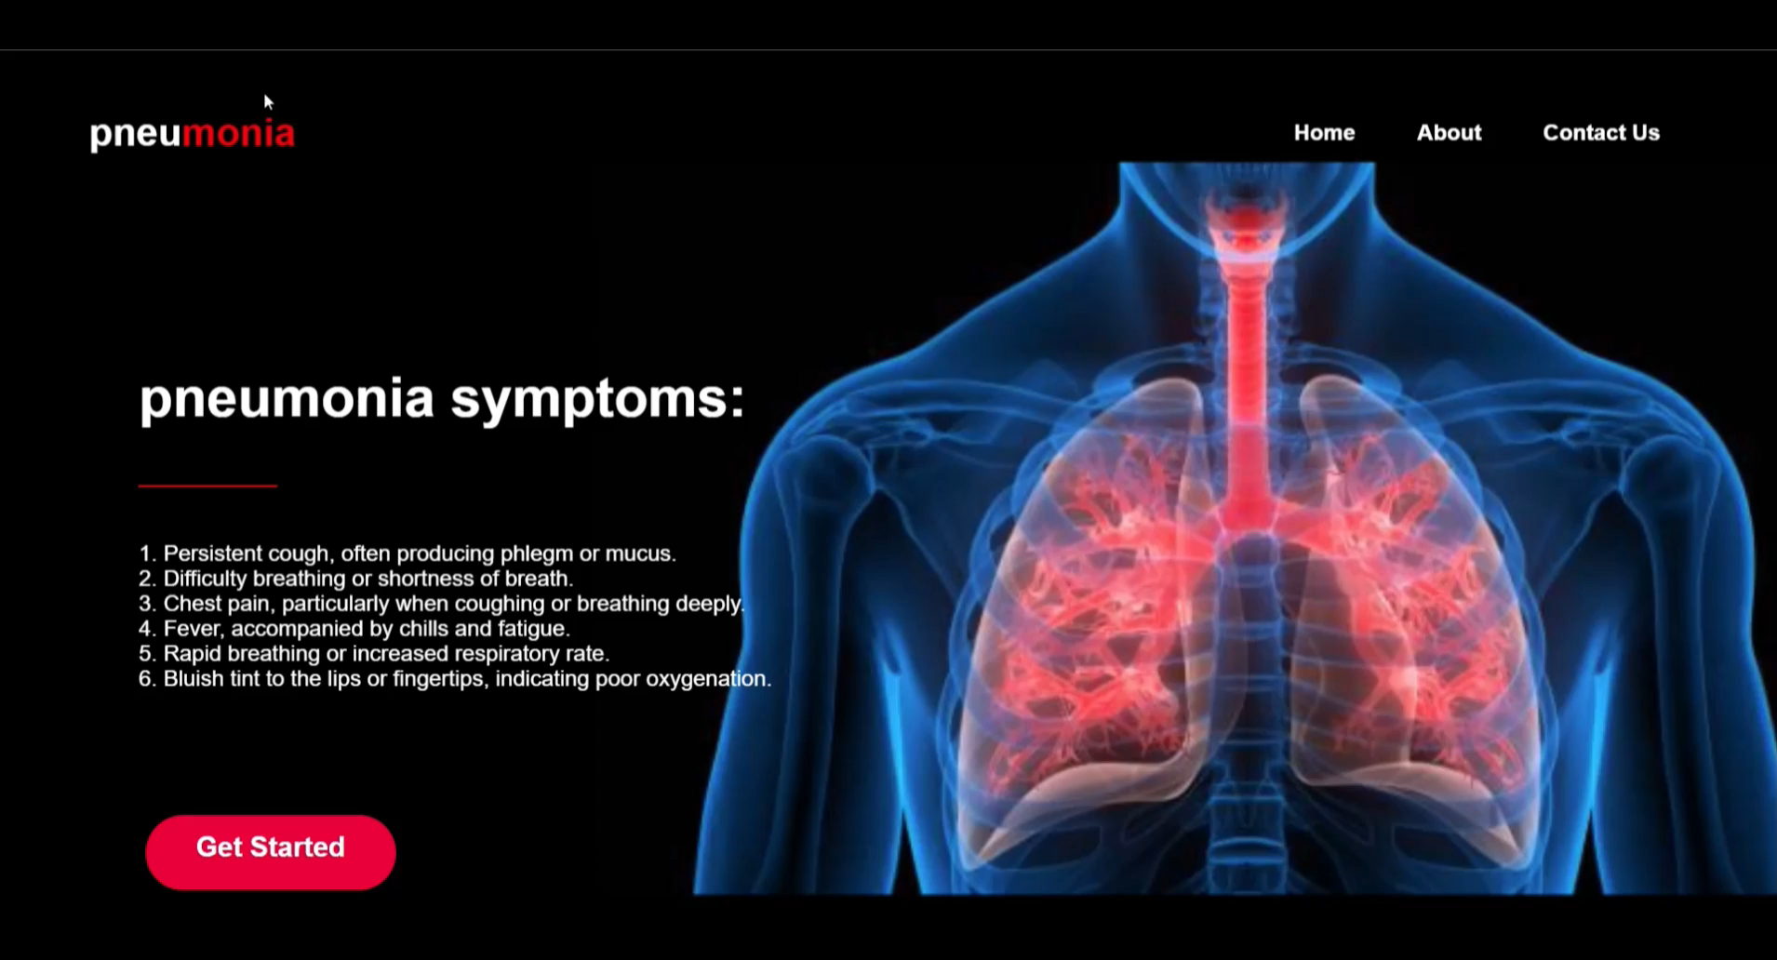
Slide 37 of 39
Demo Time

Slide 38
?
Slide 38 of 39
QUESTION
AND ANSWER
SASSION

Slide 39
Slide 39 of 39
Thank You

